Slide 1

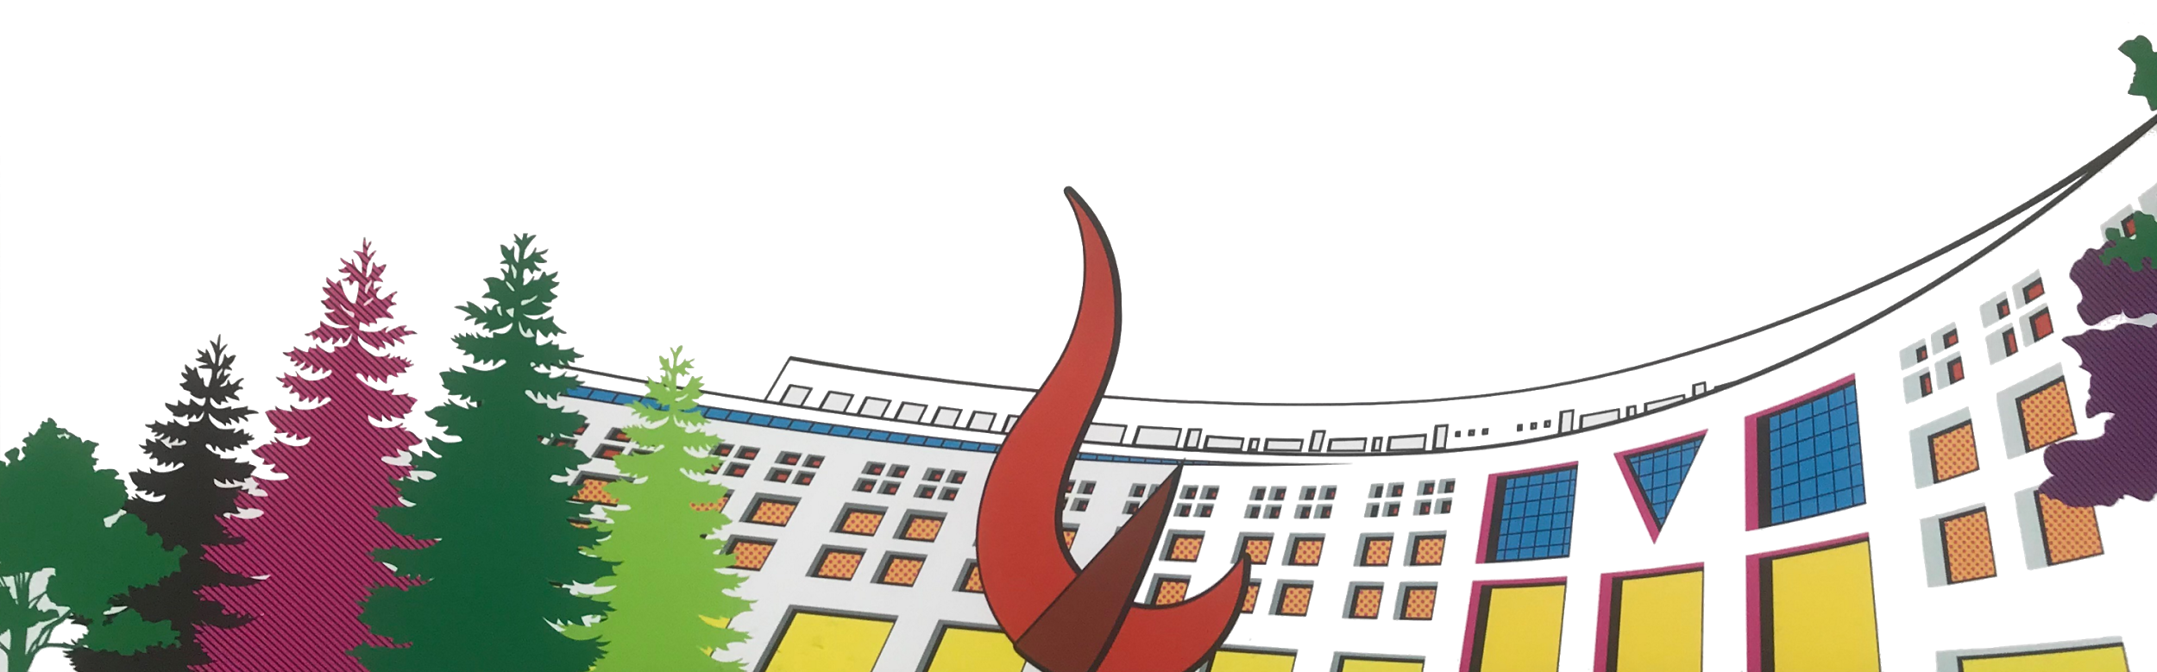

ML/DL for Everyone with
Lecture 11: Advanced CNN
Sung Kim <hunkim+ml@gmail.com> HKUST
Code: https://github.com/hunkim/PyTorchZeroToAll
Slides: http://bit.ly/PyTorchZeroAll
Videos: http://bit.ly/PyTorchVideo

Slide 2

Call for Comments
Please feel free to add comments directly on these slides.
Other slides: http://bit.ly/PyTorchZeroAll
Picture from http://www.tssablog.org/archives/3280

Slide 3
ML/DL for Everyone with
Lecture 11: Advanced CNN
Sung Kim <hunkim+ml@gmail.com> HKUST
Code: https://github.com/hunkim/PyTorchZeroToAll
Slides: http://bit.ly/PyTorchZeroAll
Videos: http://bit.ly/PyTorchVideo

Slide 4
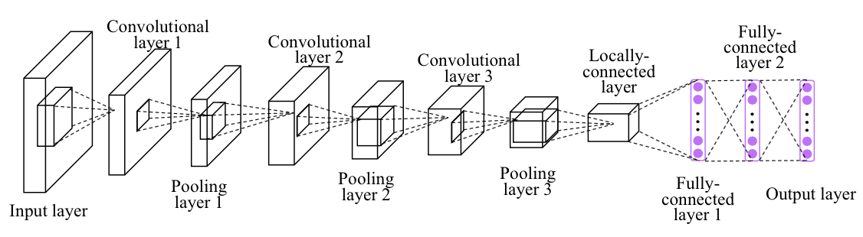
CNN

Slide 5
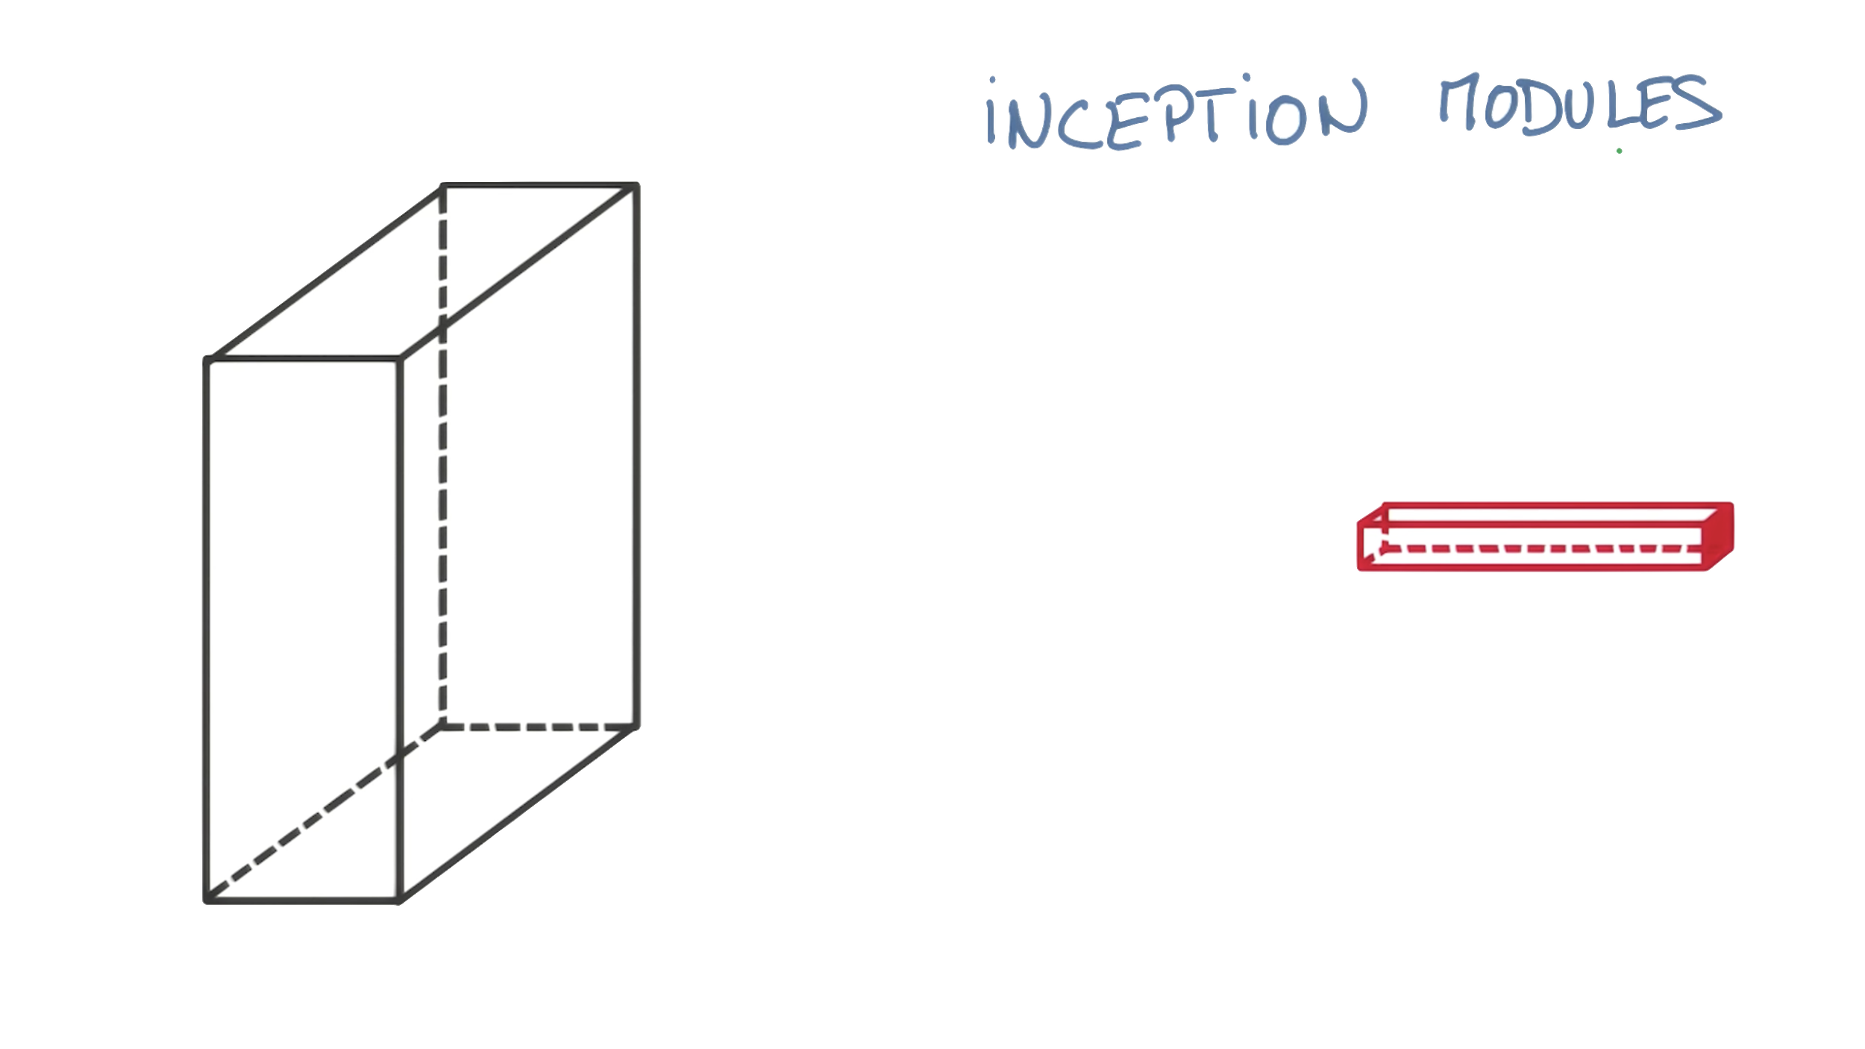
https://www.youtube.com/watch?v=VxhSouuSZDY

Slide 6
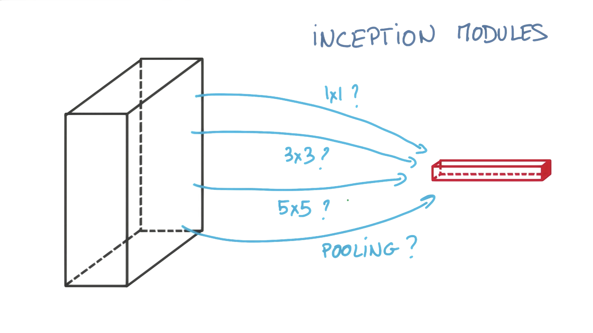
https://www.youtube.com/watch?v=VxhSouuSZDY

Slide 7
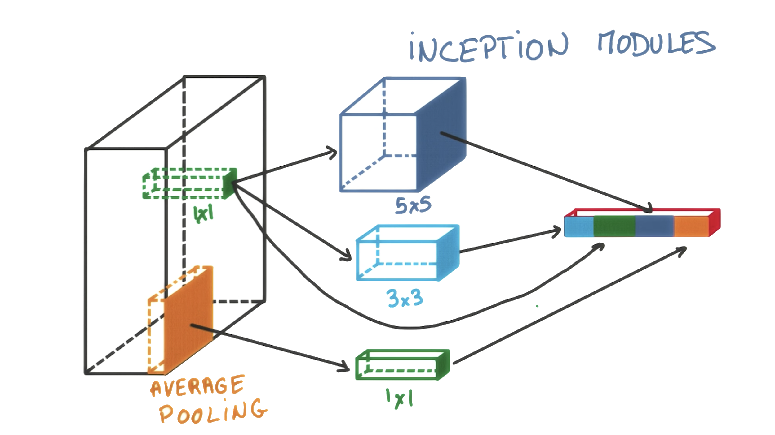
https://www.youtube.com/watch?v=VxhSouuSZDY

Slide 8
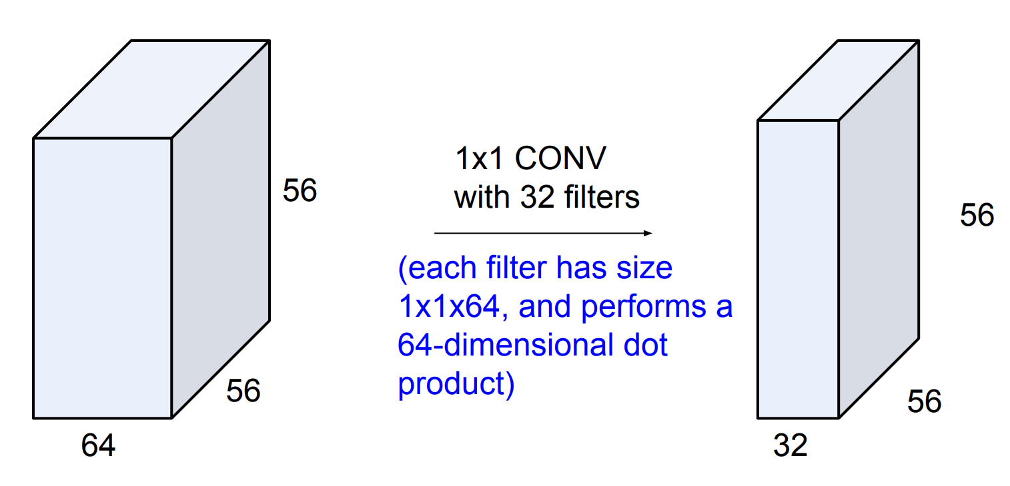
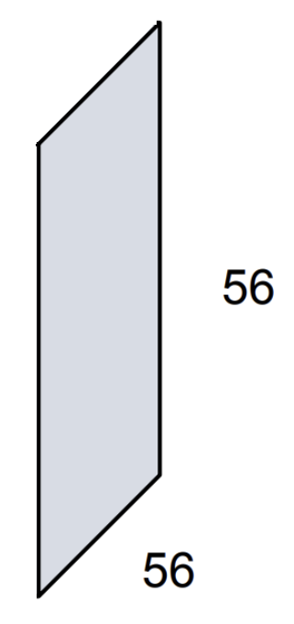
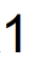
Why 1x1 convolution?
http://cs231n.stanford.edu/slides/2017/cs231n_2017_lecture5.pdf

Slide 9
Why 1x1 convolution?
http://cs231n.stanford.edu/slides/2017/cs231n_2017_lecture5.pdf

Slide 10
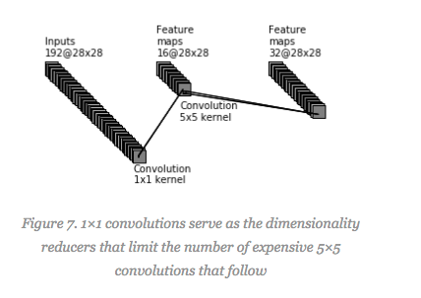
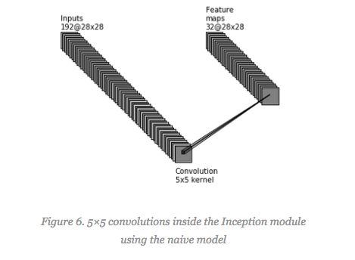
Why 1x1 convolution?
https://hacktilldawn.com/2016/09/25/inception-modules-explained-and-implemented/

Slide 11
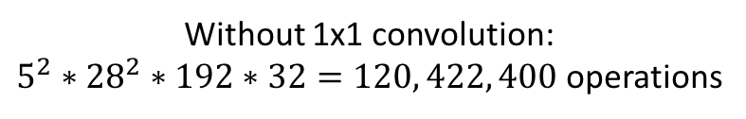
Why 1x1 convolution?
https://hacktilldawn.com/2016/09/25/inception-modules-explained-and-implemented/

Slide 12
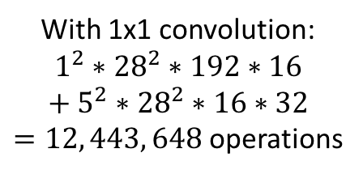
Why 1x1 convolution?
https://hacktilldawn.com/2016/09/25/inception-modules-explained-and-implemented/

Slide 13
https://www.youtube.com/watch?v=VxhSouuSZDY

Slide 14

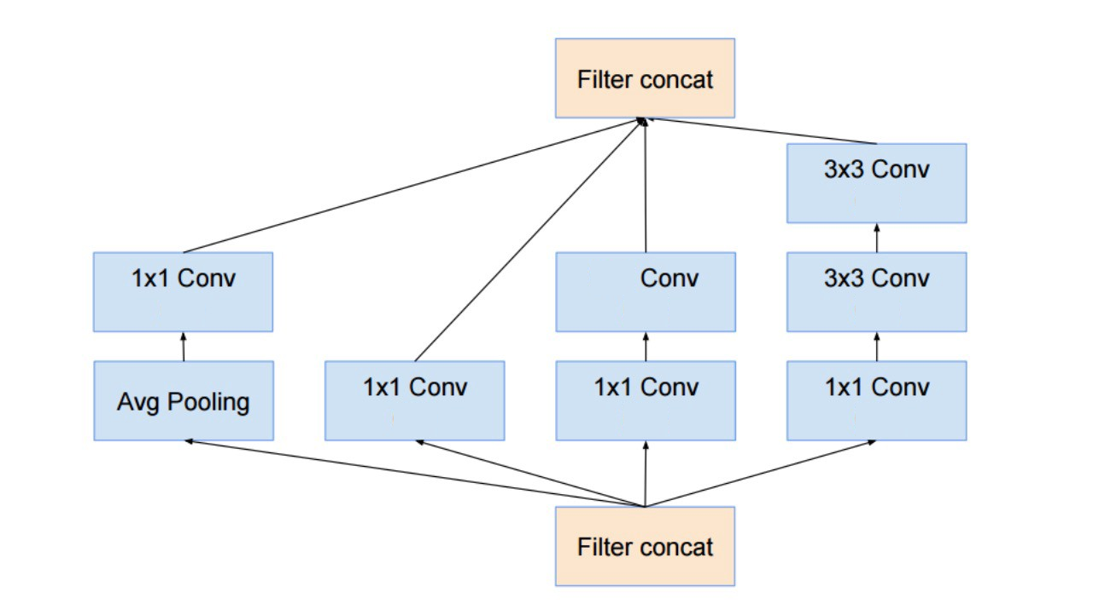
Inception Module
(24)
5x5
(24)
(24)
(24)
(16)
(16)
(16)
https://hacktilldawn.com/2016/09/25/inception-modules-explained-and-implemented/

Slide 15
(24)
5x5
(24)
(24)
(24)
(16)
(16)
(16)

Slide 16
self.branch1x1 = nn.Conv2d(in_channels, 16, kernel_size=1)
branch1x1 = self.branch1x1(x)
(24)
5x5
(24)
(24)
(24)
(16)
(16)
(16)

Slide 17
self.branch_pool = nn.Conv2d(in_channels, 24, kernel_size=1)
branch_pool = F.avg_pool2d(x, kernel_size=3, stride=1, padding=1)
branch_pool = self.branch_pool(branch_pool)
self.branch1x1 = nn.Conv2d(in_channels, 16, kernel_size=1)
branch1x1 = self.branch1x1(x)
(24)
5x5
(24)
(24)
(24)
(16)
(16)
(16)

Slide 18
self.branch_pool = nn.Conv2d(in_channels, 24, kernel_size=1)
branch_pool = F.avg_pool2d(x, kernel_size=3, stride=1, padding=1)
branch_pool = self.branch_pool(branch_pool)
self.branch1x1 = nn.Conv2d(in_channels, 16, kernel_size=1)
branch1x1 = self.branch1x1(x)
(24)
5x5
(24)
(24)
(24)
self.branch5x5_1 = nn.Conv2d(in_channels, 16, kernel_size=1)
self.branch5x5_2 = nn.Conv2d(16, 24, kernel_size=5, padding=2)
branch5x5 = self.branch5x5_1(x)
branch5x5 = self.branch5x5_2(branch5x5)
(16)
(16)
(16)

Slide 19
self.branch_pool = nn.Conv2d(in_channels, 24, kernel_size=1)
branch_pool = F.avg_pool2d(x, kernel_size=3, stride=1, padding=1)
branch_pool = self.branch_pool(branch_pool)
self.branch1x1 = nn.Conv2d(in_channels, 16, kernel_size=1)
branch1x1 = self.branch1x1(x)
(24)
5x5
(24)
(24)
(24)
self.branch5x5_1 = nn.Conv2d(in_channels, 16, kernel_size=1)
self.branch5x5_2 = nn.Conv2d(16, 24, kernel_size=5, padding=2)
branch5x5 = self.branch5x5_1(x)
branch5x5 = self.branch5x5_2(branch5x5)
(16)
(16)
(16)
self.branch3x3dbl_1 = nn.Conv2d(in_channels, 16, kernel_size=1)
self.branch3x3dbl_2 = nn.Conv2d(16, 24, kernel_size=3, padding=1)
self.branch3x3dbl_3 = nn.Conv2d(24, 24, kernel_size=3, padding=1)
branch3x3dbl = self.branch3x3dbl_1(x)
branch3x3dbl = self.branch3x3dbl_2(branch3x3dbl)
branch3x3dbl = self.branch3x3dbl_3(branch3x3dbl)

Slide 20
self.branch_pool = nn.Conv2d(in_channels, 24, kernel_size=1)
branch_pool = F.avg_pool2d(x, kernel_size=3, stride=1, padding=1)
branch_pool = self.branch_pool(branch_pool)
outputs =
[branch1x1,
branch5x5,
branch3x3dbl,
branch_pool]
self.branch1x1 = nn.Conv2d(in_channels, 16, kernel_size=1)
branch1x1 = self.branch1x1(x)
(24)
5x5
(24)
(24)
(24)
self.branch5x5_1 = nn.Conv2d(in_channels, 16, kernel_size=1)
self.branch5x5_2 = nn.Conv2d(16, 24, kernel_size=5, padding=2)
branch5x5 = self.branch5x5_1(x)
branch5x5 = self.branch5x5_2(branch5x5)
(16)
(16)
(16)
self.branch3x3dbl_1 = nn.Conv2d(in_channels, 16, kernel_size=1)
self.branch3x3dbl_2 = nn.Conv2d(16, 24, kernel_size=3, padding=1)
self.branch3x3dbl_3 = nn.Conv2d(24, 24, kernel_size=3, padding=1)
branch3x3dbl = self.branch3x3dbl_1(x)
branch3x3dbl = self.branch3x3dbl_2(branch3x3dbl)
branch3x3dbl = self.branch3x3dbl_3(branch3x3dbl)

Slide 21
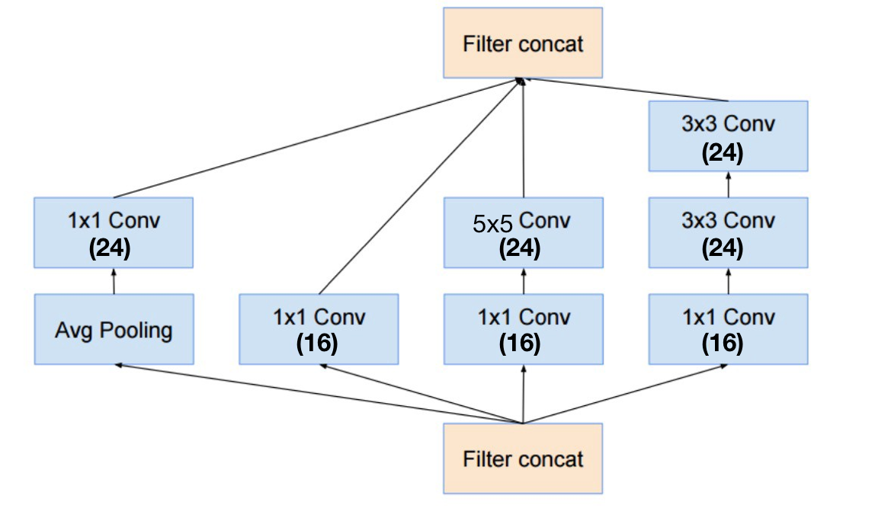
Inception Module
class InceptionA(nn.Module):
def __init__(self, in_channels):
super(InceptionA, self).__init__()
self.branch1x1 = nn.Conv2d(in_channels, 16, kernel_size=1)
self.branch5x5_1 = nn.Conv2d(in_channels, 16, kernel_size=1)
self.branch5x5_2 = nn.Conv2d(16, 24, kernel_size=5, padding=2)
self.branch3x3dbl_1 = nn.Conv2d(in_channels, 16, kernel_size=1)
self.branch3x3dbl_2 = nn.Conv2d(16, 24, kernel_size=3, padding=1)
self.branch3x3dbl_3 = nn.Conv2d(24, 24, kernel_size=3, padding=1)
self.branch_pool = nn.Conv2d(in_channels, 24, kernel_size=1)
def forward(self, x):
branch1x1 = self.branch1x1(x)
branch5x5 = self.branch5x5_1(x)
branch5x5 = self.branch5x5_2(branch5x5)
branch3x3dbl = self.branch3x3dbl_1(x)
branch3x3dbl = self.branch3x3dbl_2(branch3x3dbl)
branch3x3dbl = self.branch3x3dbl_3(branch3x3dbl)
branch_pool = F.avg_pool2d(x, kernel_size=3, stride=1, padding=1)
branch_pool = self.branch_pool(branch_pool)
outputs = [branch1x1, branch5x5, branch3x3dbl, branch_pool]
return torch.cat(outputs, 1)
class Net(nn.Module):
def __init__(self):
super(Net, self).__init__()
self.conv1 = nn.Conv2d(1, 10, kernel_size=5)
self.conv2 = nn.Conv2d(88, 20, kernel_size=5)
self.incept1 = InceptionA(in_channels=10)
self.incept2 = InceptionA(in_channels=20)
self.mp = nn.MaxPool2d(2)
self.fc = nn.Linear(1408, 10)
def forward(self, x):
in_size = x.size(0)
x = F.relu(self.mp(self.conv1(x)))
x = self.incept1(x)
x = F.relu(self.mp(self.conv2(x)))
x = self.incept2(x)
x = x.view(in_size, -1) # flatten the tensor
x = self.fc(x)
return F.log_softmax(x)
https://github.com/.../torchvision/models/inception.py
Notes:
\hat{y}=x*w+b
loss = \frac{1}{N}\sum_{n=1}^{N} y^{(n)} \log \hat{y}^{(n)} + (1 - y^{(n)}) \log (1-\hat{y}^{(n})

Slide 22
Inception Module
Train Epoch: 9 [44800/60000 (75%)] Loss: 0.064180
Train Epoch: 9 [45440/60000 (76%)] Loss: 0.020339
Train Epoch: 9 [46080/60000 (77%)] Loss: 0.061476
Train Epoch: 9 [46720/60000 (78%)] Loss: 0.039662
Train Epoch: 9 [47360/60000 (79%)] Loss: 0.026798
Train Epoch: 9 [48000/60000 (80%)] Loss: 0.071569
Train Epoch: 9 [48640/60000 (81%)] Loss: 0.003835
Train Epoch: 9 [49280/60000 (82%)] Loss: 0.005564
Train Epoch: 9 [49920/60000 (83%)] Loss: 0.020116
Train Epoch: 9 [50560/60000 (84%)] Loss: 0.128114
Train Epoch: 9 [51200/60000 (85%)] Loss: 0.016599
Train Epoch: 9 [51840/60000 (86%)] Loss: 0.006995
Train Epoch: 9 [52480/60000 (87%)] Loss: 0.111267
Train Epoch: 9 [53120/60000 (88%)] Loss: 0.052126
Train Epoch: 9 [53760/60000 (90%)] Loss: 0.034962
Train Epoch: 9 [54400/60000 (91%)] Loss: 0.029465
Train Epoch: 9 [55040/60000 (92%)] Loss: 0.031482
Train Epoch: 9 [55680/60000 (93%)] Loss: 0.015132
Train Epoch: 9 [56320/60000 (94%)] Loss: 0.010435
Train Epoch: 9 [56960/60000 (95%)] Loss: 0.014344
Train Epoch: 9 [57600/60000 (96%)] Loss: 0.014952
Train Epoch: 9 [58240/60000 (97%)] Loss: 0.153132
Train Epoch: 9 [58880/60000 (98%)] Loss: 0.112024
Train Epoch: 9 [59520/60000 (99%)] Loss: 0.009406
Test set: Average loss: 0.0470, Accuracy: 9866/10000 (99%)
class Net(nn.Module):
def __init__(self):
super(Net, self).__init__()
self.conv1 = nn.Conv2d(1, 10, kernel_size=5)
self.conv2 = nn.Conv2d(88, 20, kernel_size=5)
self.incept1 = InceptionA(in_channels=10)
self.incept2 = InceptionA(in_channels=20)
self.mp = nn.MaxPool2d(2)
self.fc = nn.Linear(1408, 10)
def forward(self, x):
in_size = x.size(0)
x = F.relu(self.mp(self.conv1(x)))
x = self.incept1(x)
x = F.relu(self.mp(self.conv2(x)))
x = self.incept2(x)
x = x.view(in_size, -1) # flatten the tensor
x = self.fc(x)
return F.log_softmax(x)
Notes:
\hat{y}=x*w+b
loss = \frac{1}{N}\sum_{n=1}^{N} y^{(n)} \log \hat{y}^{(n)} + (1 - y^{(n)}) \log (1-\hat{y}^{(n})

Slide 23
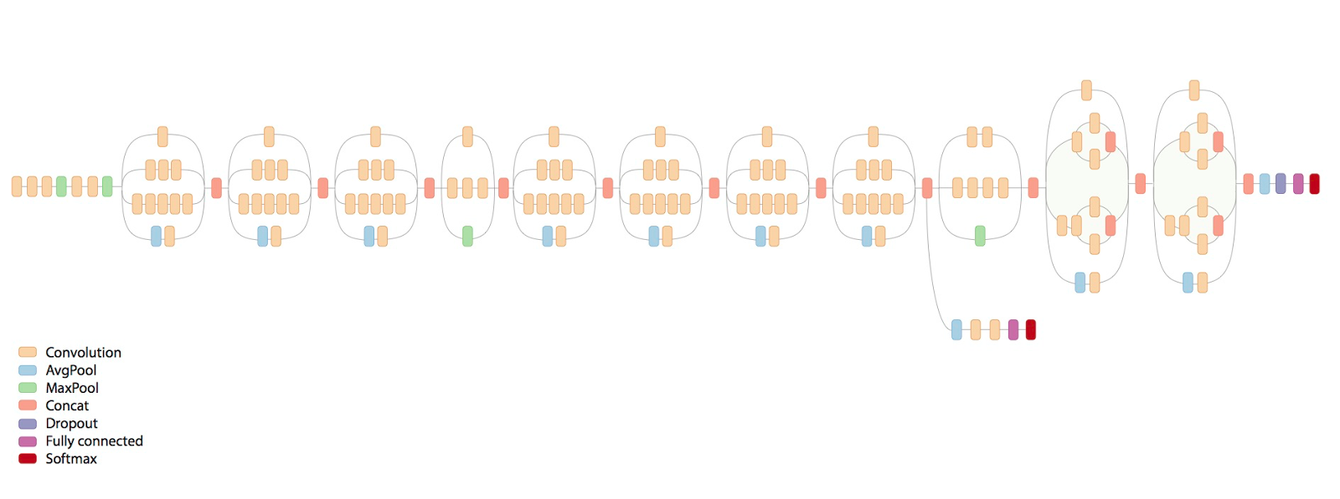
Exercise 11-1: Implement full inception v3/v4
https://research.googleblog.com/2016/08/improving-inception-and-image.html

Slide 24

https://www.youtube.com/watch?v=C6tLw-rPQ2o

Slide 25
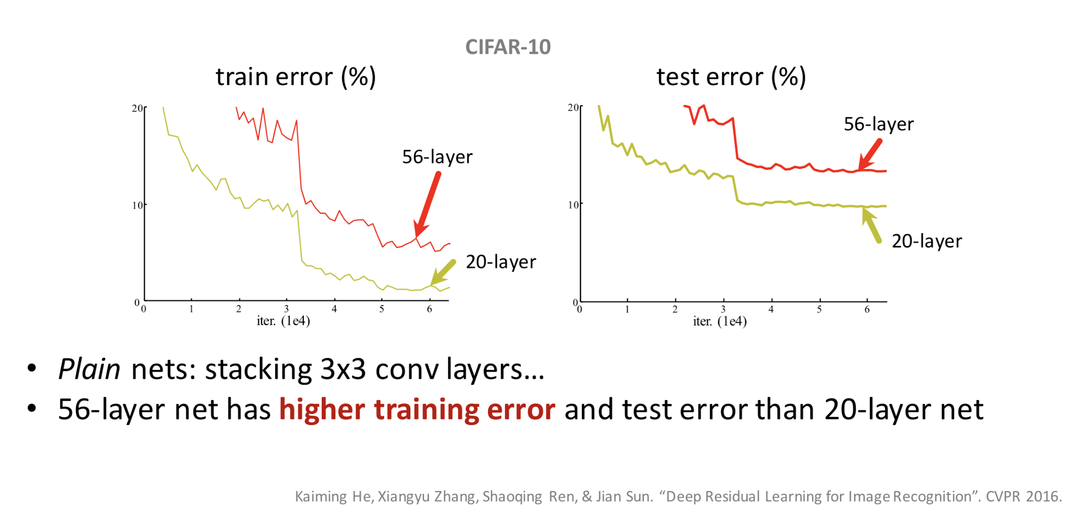
Can we just go deeper, keep stacking layers?
http://icml.cc/2016/tutorials/icml2016_tutorial_deep_residual_networks_kaiminghe.pdf

Slide 26
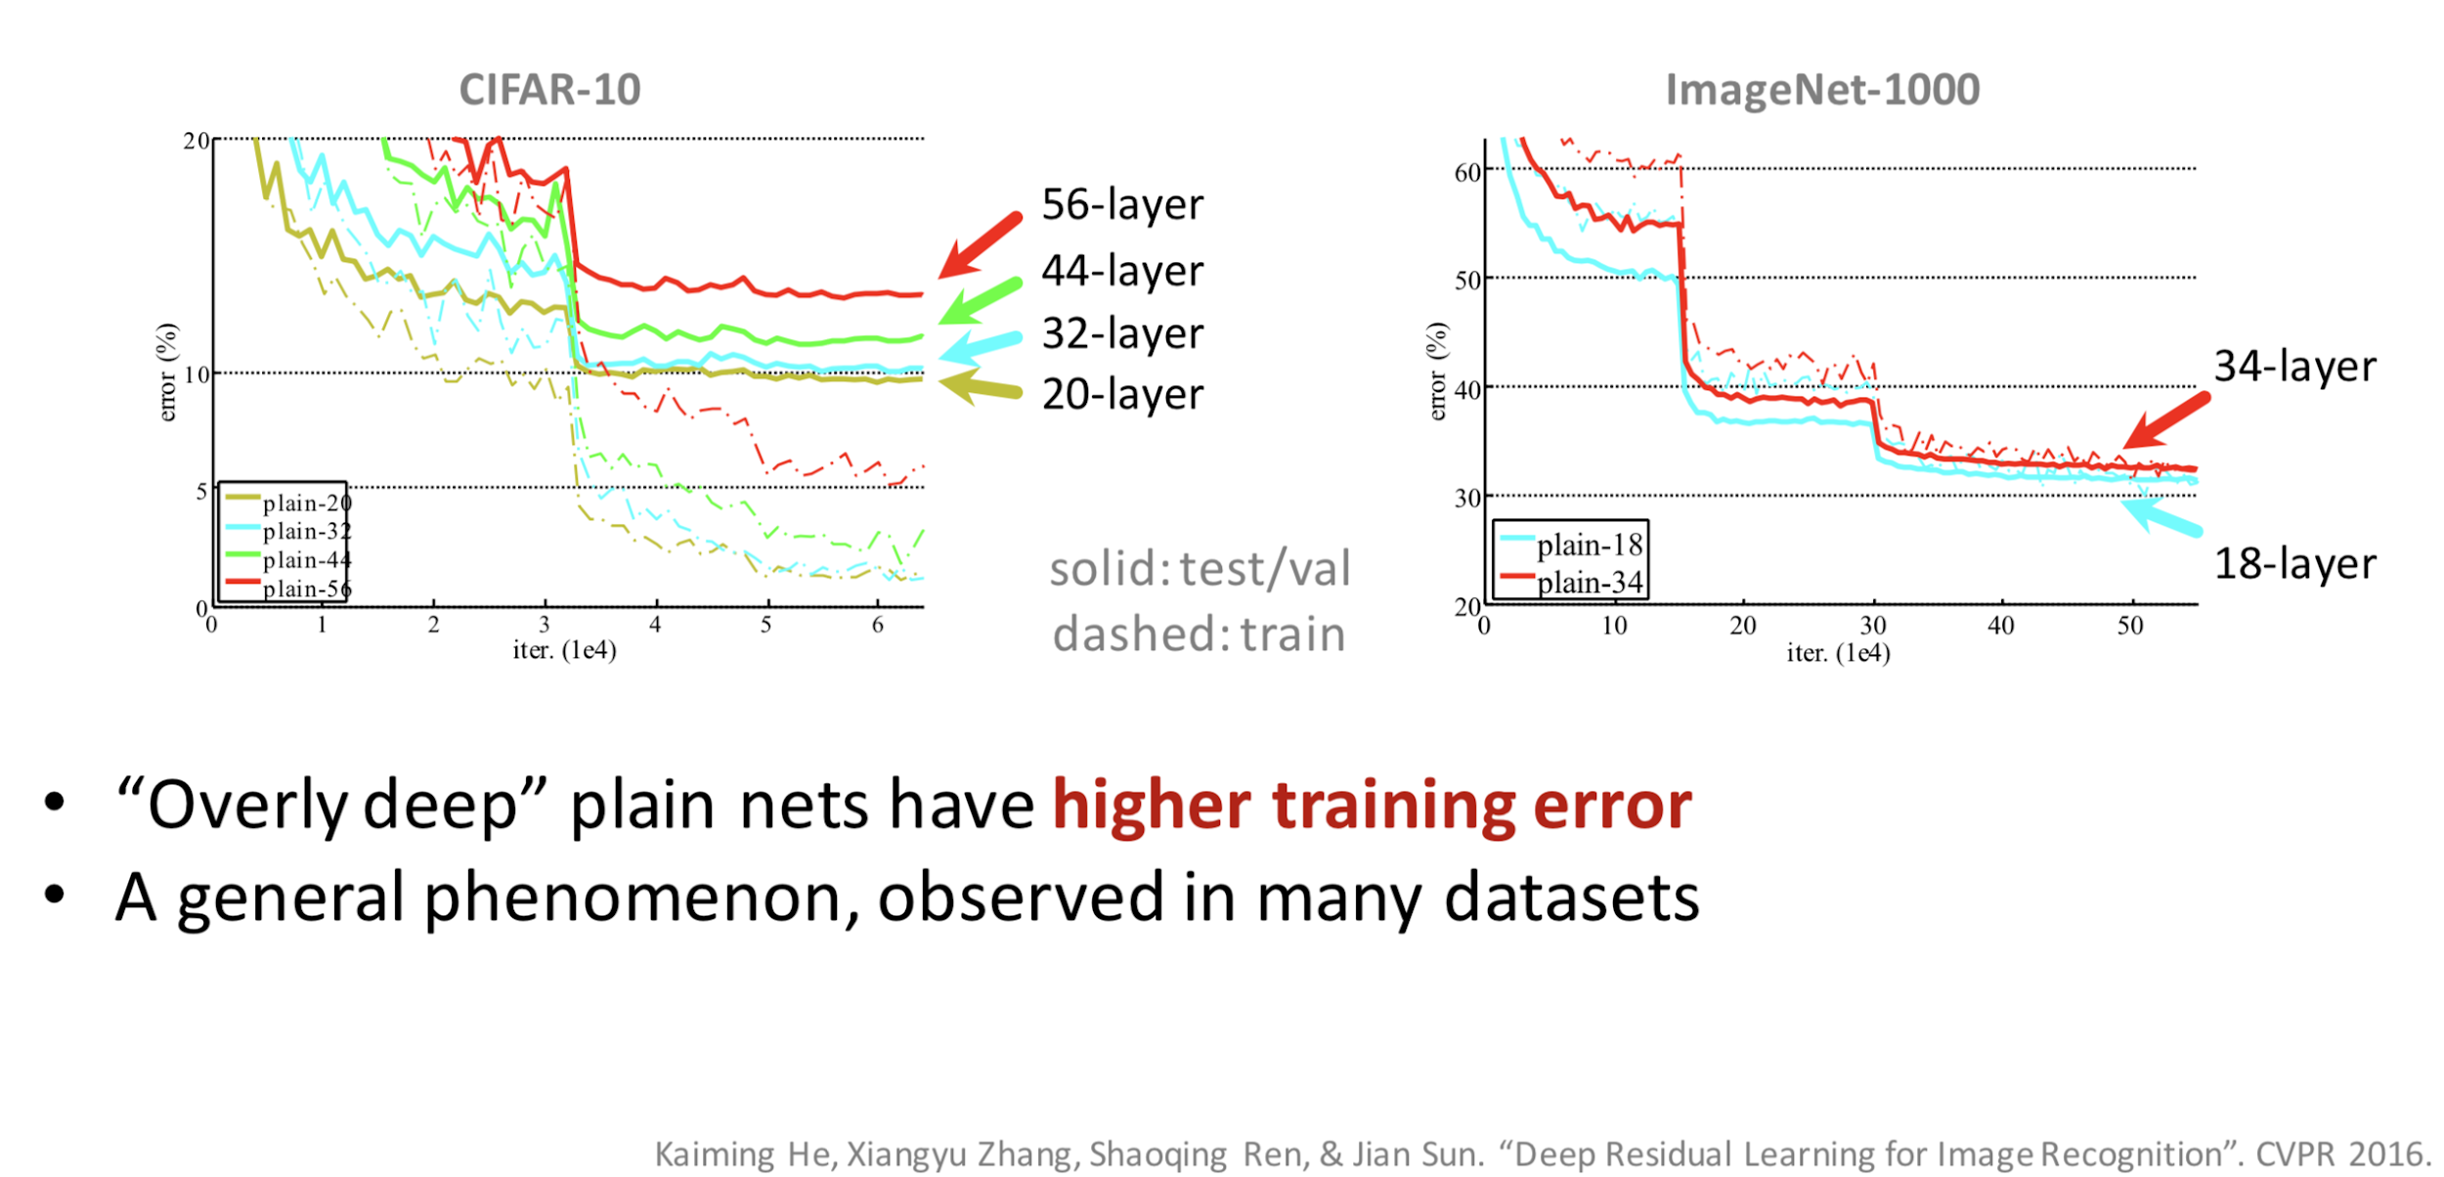
Can we just go deeper, keep stacking layers?
http://icml.cc/2016/tutorials/icml2016_tutorial_deep_residual_networks_kaiminghe.pdf

Slide 27
Problems with stacking layers (TBA)
Vanishing gradients problem
Back propagation kind of gives up…
Degradation problem
with increased network depth accuracy gets saturated and then rapidly degrades

Slide 28
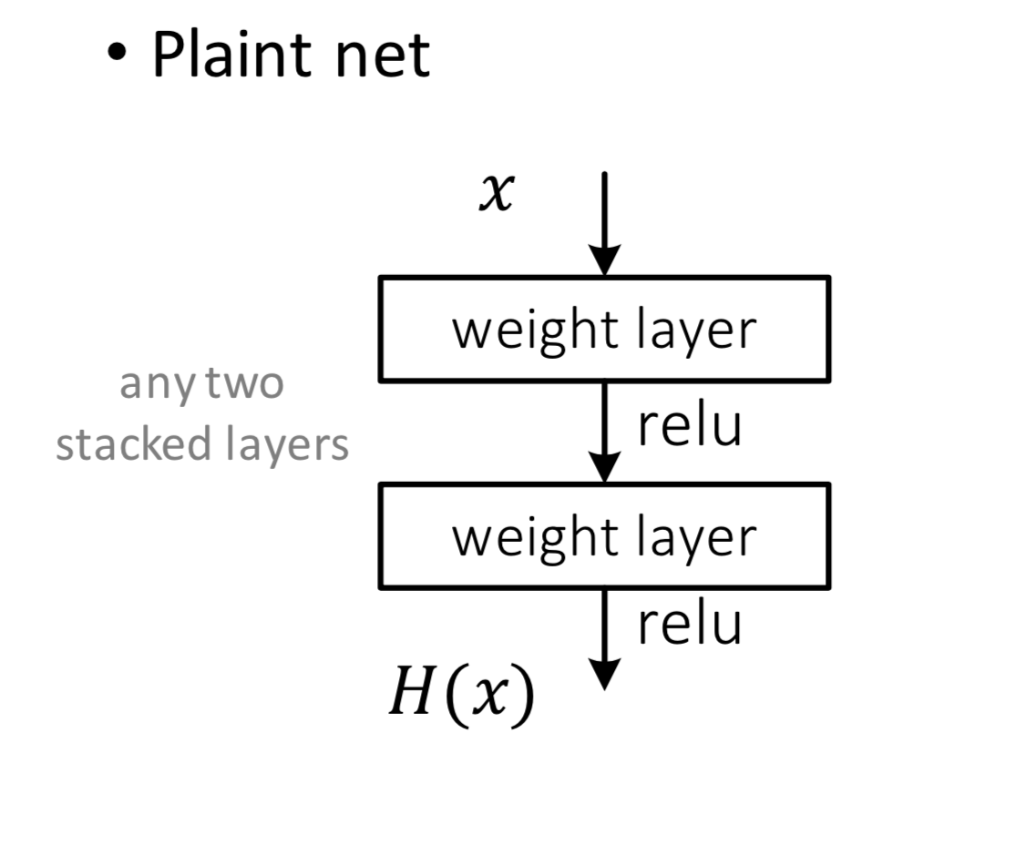

Deep Residual Learning

Slide 29
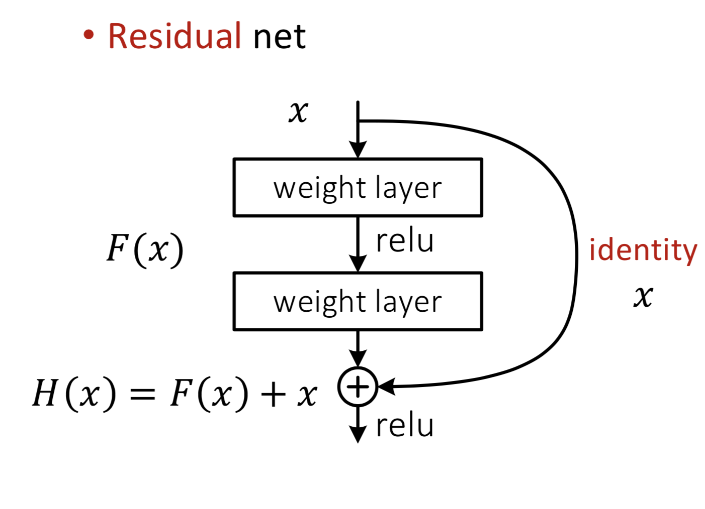
Deep Residual Learning

Slide 30
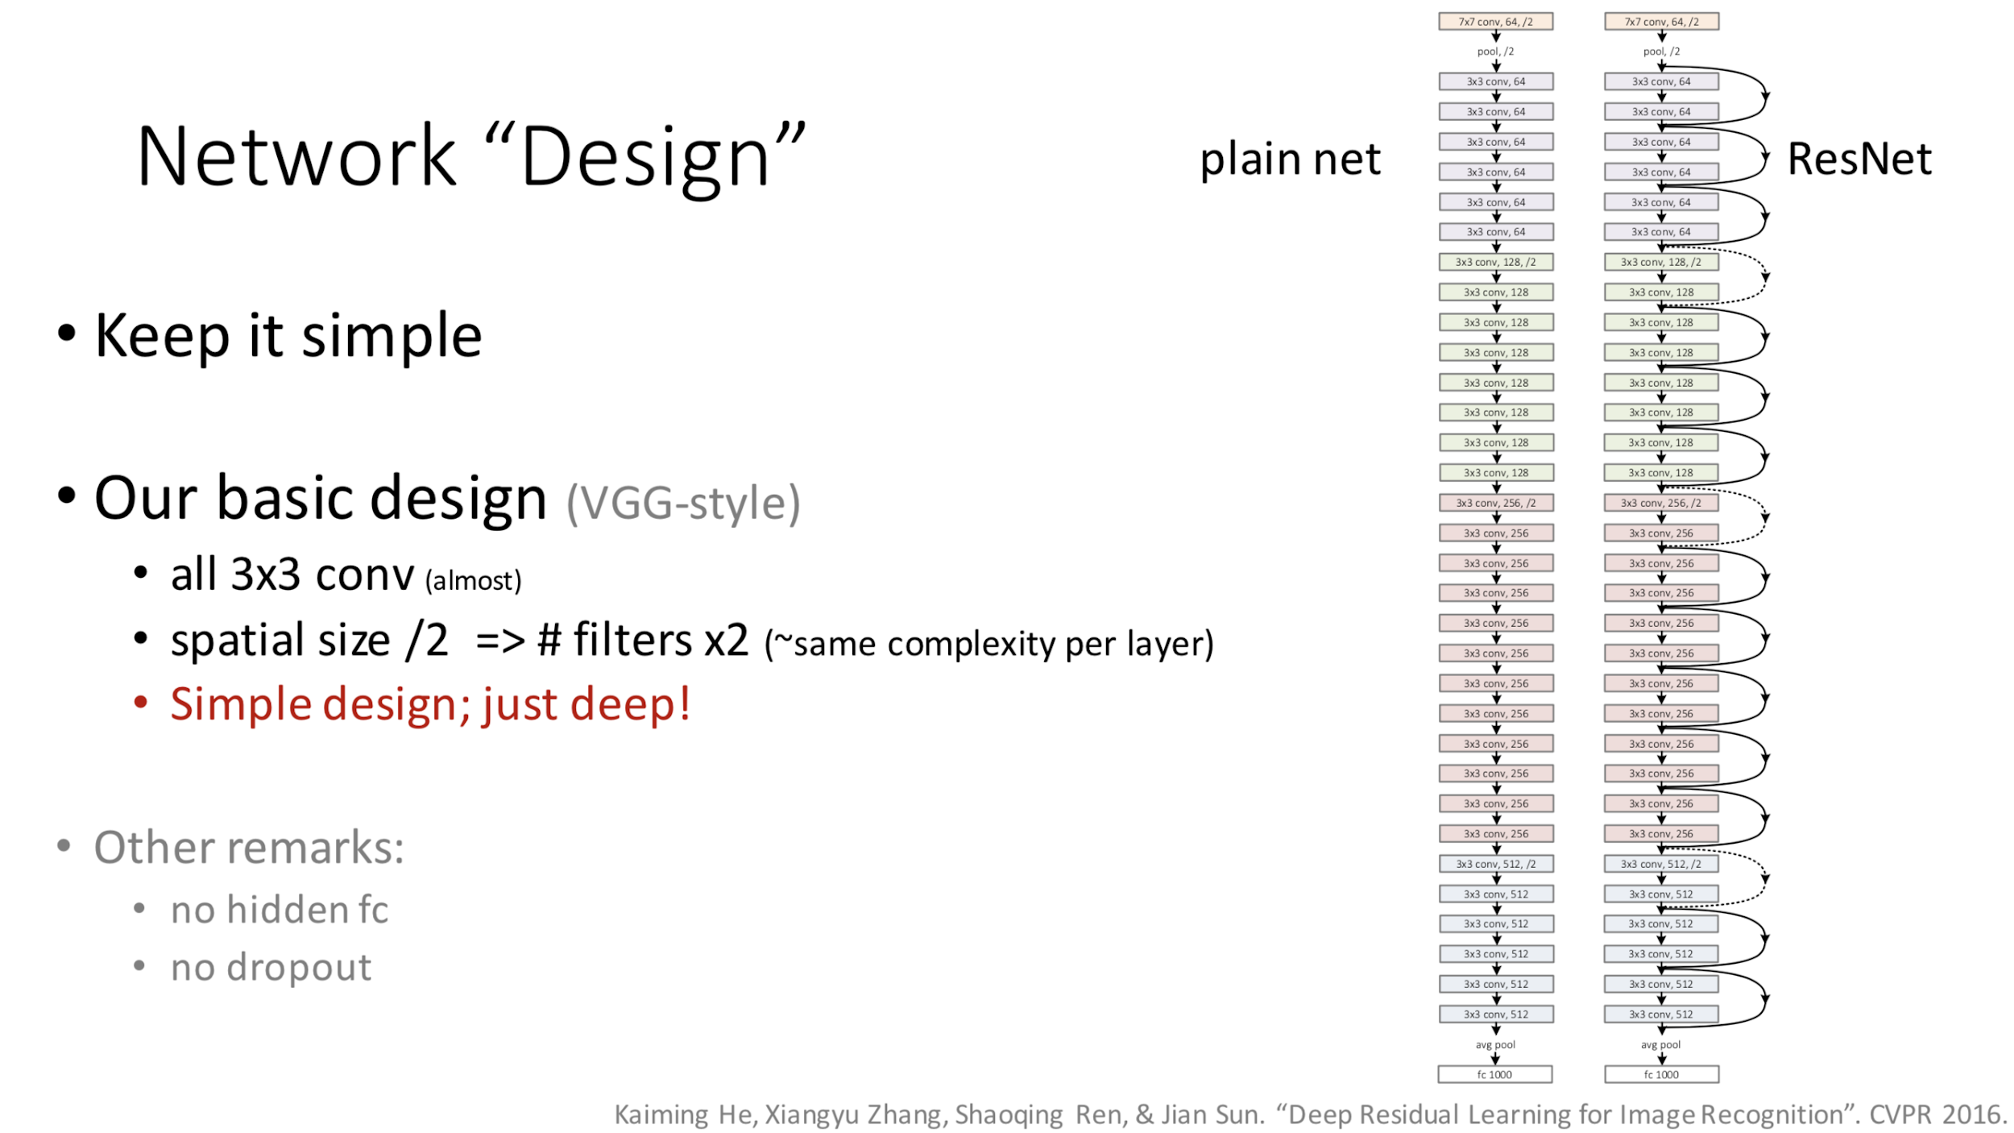
http://icml.cc/2016/tutorials/icml2016_tutorial_deep_residual_networks_kaiminghe.pdf

Slide 31
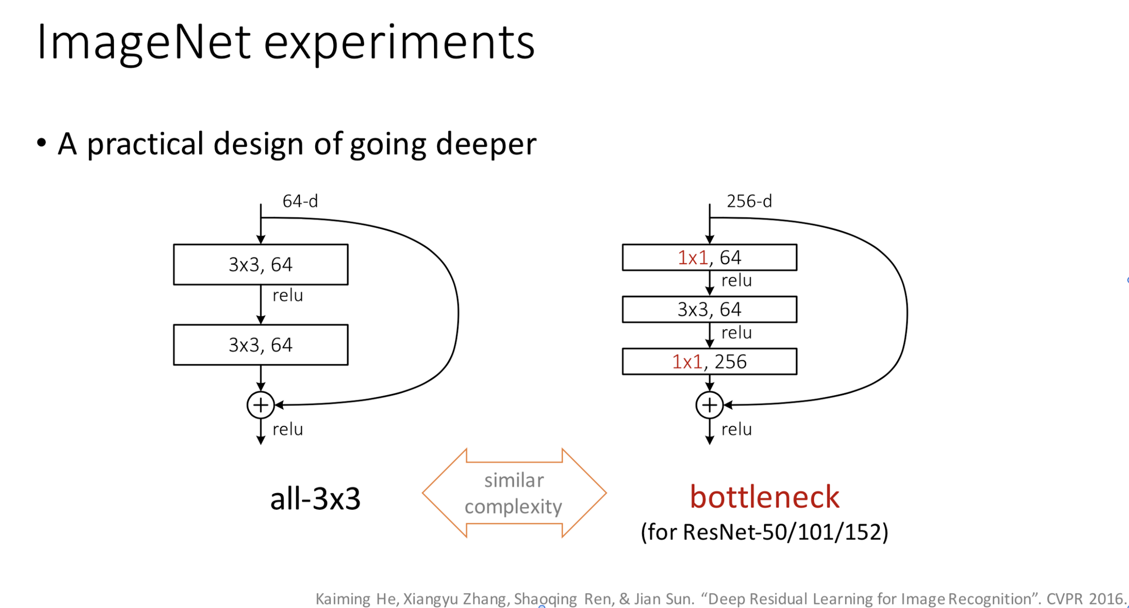
http://icml.cc/2016/tutorials/icml2016_tutorial_deep_residual_networks_kaiminghe.pdf

Slide 32
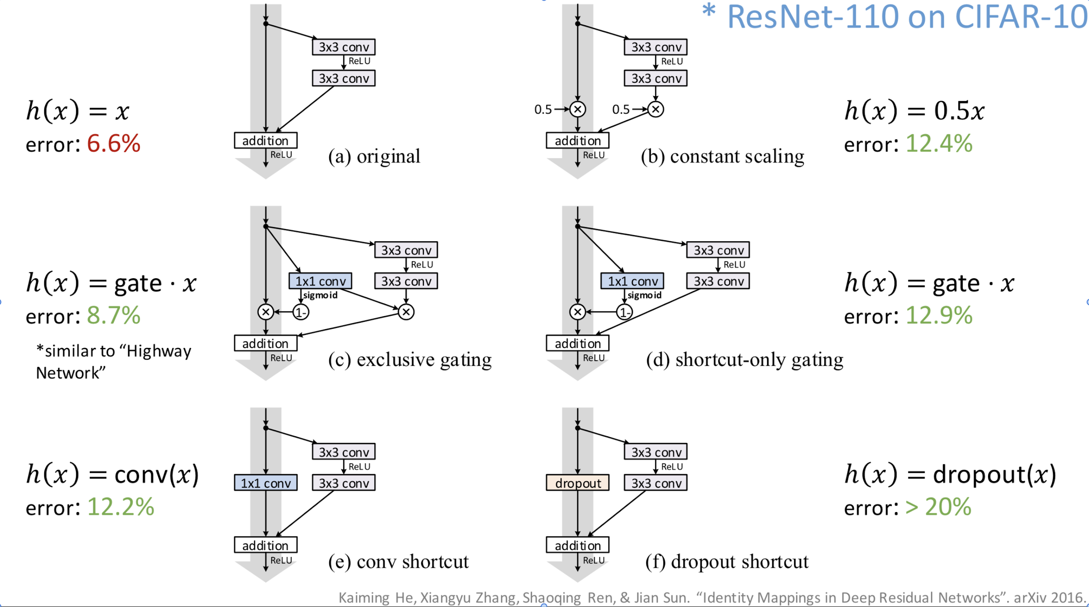
Many more experiments!

Slide 33
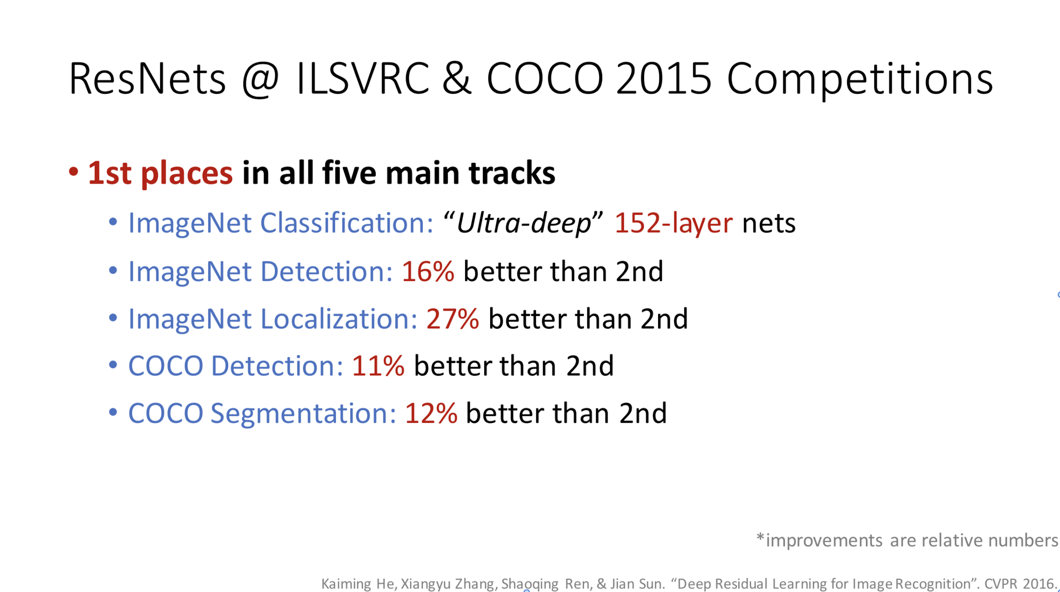
http://icml.cc/2016/tutorials/icml2016_tutorial_deep_residual_networks_kaiminghe.pdf

Slide 34
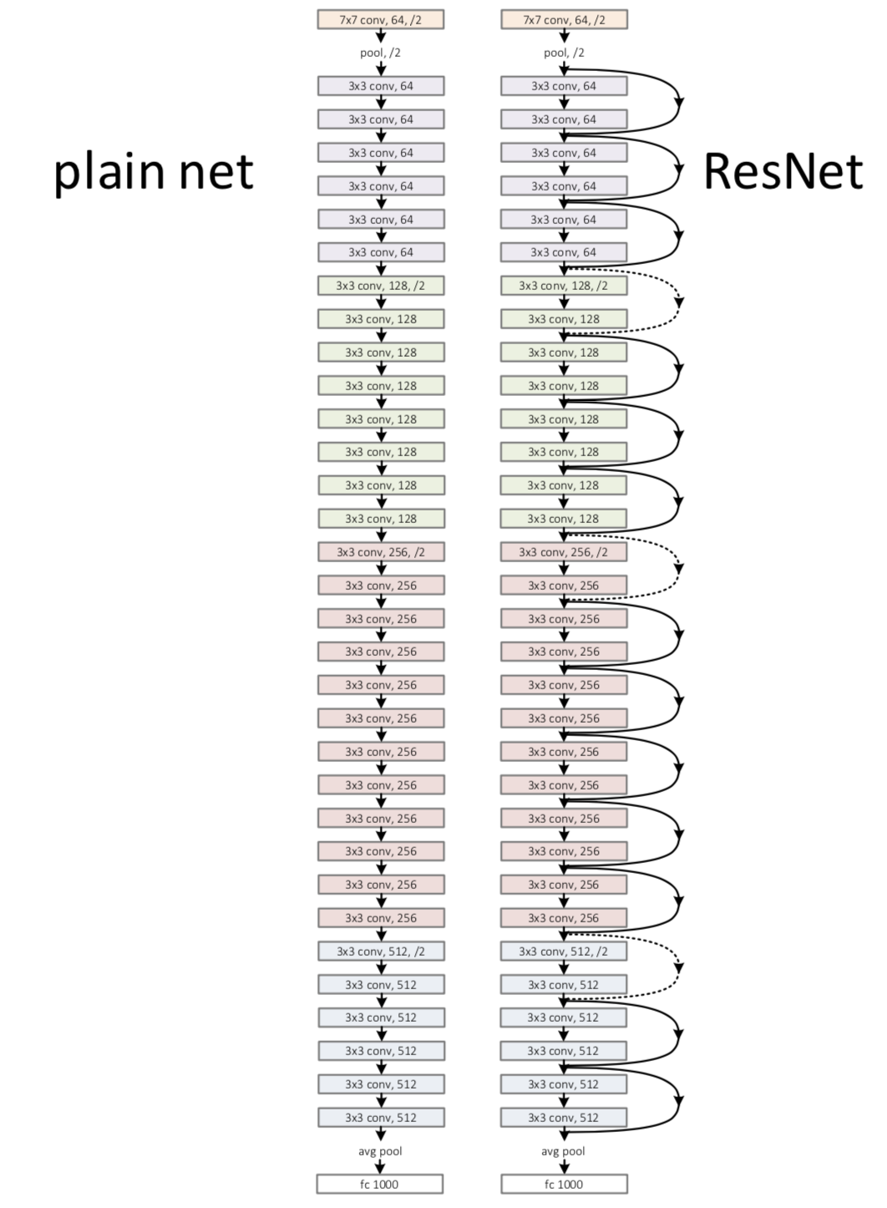
Exercise 11-2: Implement ResNet
Try to implement from scratch
Deep Residual Learning for Image Recognition: https://arxiv.org/abs/1512.03385
Identity Mappings in Deep Residual Networks: https://arxiv.org/abs/1603.05027
http://icml.cc/2016/tutorials/icml2016_tutorial_deep_residual_networks_kaiminghe.pdf

Slide 35
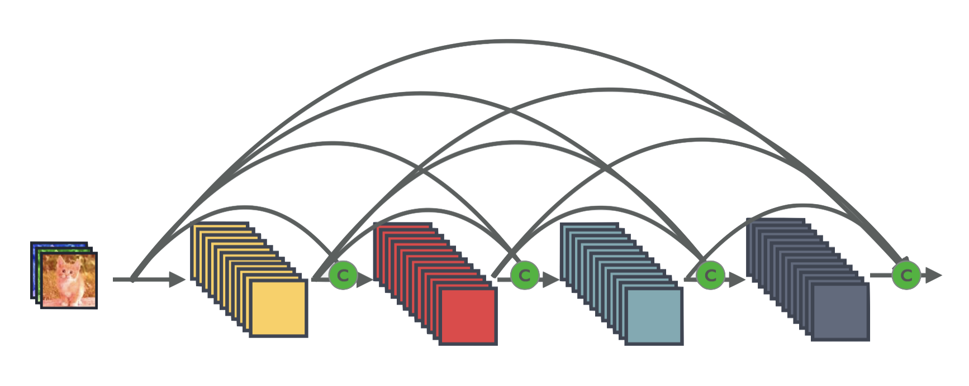
Exercise 11-3: Implement DenseNet
https://arxiv.org/abs/1608.06993

Slide 36


Lecture 12: RNN

